Slide 1
Chapter 2: Stellaris® family of microcontrollers
Stellaris® CortexTM-M3 - Microcontroller Family
Texas Instruments
Texas Instruments - University Program
Heilbronn University, Campus Künzelsau
Prof. Dr.-Ing. Ralf Gessler Rev. 1.0

Slide 2
Contents
Chapter 2: Stellaris® family of microcontrollers 2.1 Overview MCU 2.2 CortexTM -M3: Processor and Peripherals 2.3 CortexTM -M3: Programmer model (ISA) 2.4 Peripherals
Topics: serial interface peripherals: UART, SSI, I²C; motion control peripherals: PWM, QEI; analog peripherals: ADC, analog comparators

Slide 3
Learning Objectives
The chapter describes the basics (theory) of the Stellaris® LM3S1968 device as part of the LM3S1nnn product line.
The device is used in conjunction with the Evaluation Board to run different software projects.
Three product line specific “Peripherals” are introduced. The modules are:
Serial Interface
Motion Control
Analog
Structure and questions:
What are the applications of the LM3S1968?
What are Features of the Peripherals: Serial Interface, Motion Control and Analog?

Slide 4
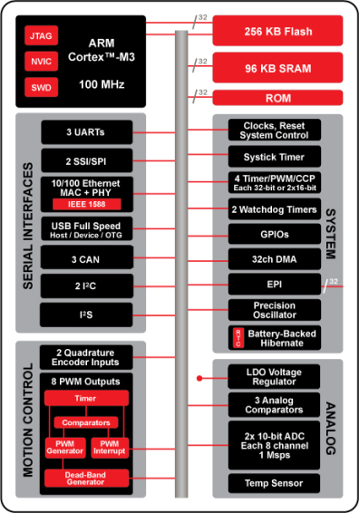

Stellaris® Family Overview
80 MHz

Slide 5
Introduction
The Stellaris® family offers efficient performance and extensive integration, favourably positioning the device into cost-conscious applications requiring significant control-processing and connectivity capabilities.
The Stellaris® LM3S1000 series extends the Stellaris® family with larger on-chip memories, enhanced power management, and expanded I/O and control capabilities.
The LM3S1968 microcontroller is targeted at industrial applications.

Slide 6
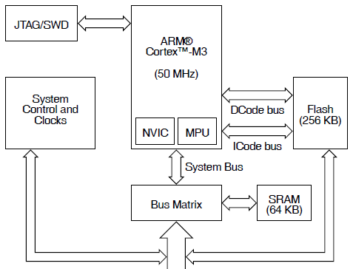
High-Level Block Diagram
Stellaris® LM3S1968 microcontroller
Link: more Details see Section 2.3 “CortexTM-M3: Programmer model (ISA)“
<A>

Slide 7
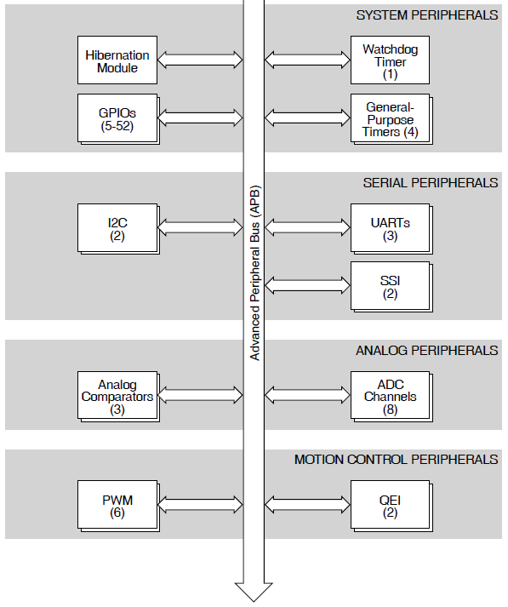
High-Level Block Diagram (cont.)
<A>
Link: more Details see Section 2.1 “Overview: MCU”

Slide 8
Target Applications
Remote monitoring
Electronic point-of-sale (POS) machines
Test and measurement equipment
Network appliances and switches
Factory automation
Heating, ventilation and Air Conditioning (HVAC) for building control
Gaming equipment
Motion control
Medical instrumentation
Fire and security
Power and energy
Transportation

Slide 9
Serial Interface Peripherals
The LM3S1968 controller supports both asynchronous and synchronous serial communications with:
Three fully programmable 16C550-type UARTs
Two SSI modules
Two I²C modules
Universal Asynchronous Receiver/Transmitter (UART)
A Universal Asynchronous Receiver/Transmitter (UART) is an integrated circuit used for RS-232C serial communications, containing a transmitter (parallel-to-serial converter) and a receiver (serial-to-parallel converter), each clocked separately.
The LM3S1968 controller includes three fully programmable 16C550-type UARTs that support data transfer speeds up to 3.125 Mbps. (Although similar in functionality to a 16C550 UART, it is not register-compatible.) In addition, each UART is capable of supporting IrDA.

Slide 10
Serial Interface Peripherals
Synchronous Serial Interface (SSI)
Is a four-wire bi-directional full and low-speed communications interface.
The LM3S1968 controller includes two SSI modules that provide the functionality for synchronous serial communications with peripheral devices. It can be configured to use the Freescale SPI (Serial Peripheral Interface), MICROWIRE, or TI synchronous serial interface frame formats. The size of the data frame is also configurable, and can be set between 4 and 16 bits, inclusively.
Inter-Integrated Circuit (I²C)
Bus provides bi-directional data transfer through a two-wire design (a serial data line SDA and a serial clock line SCL).
The I²C bus interfaces to external I²C devices such as serial memory (RAM and ROM), networking devices, LCDs, tone generators, and so on. The I²C bus may also be used for system testing and diagnostic purposes in product development and manufacture.

Slide 11
Features
UART
Three fully programmable 16C550-type UARTs with IrDA support
Programmable baud-rate generator allowing speeds up to 3.125 Mbps
SSI
Two SSI modules, each with the following features:
Master or slave operation
Programmable clock bit rate and pre-scaler
Programmable interface operation for Freescale SPI, MICROWIRE, or Texas Instruments synchronous serial interfaces
I²C
Two I²C modules
Two transmission speeds: Standard (100 Kbps) and Fast (400 Kbps)

Slide 12
Motion Control Peripherals
To enhance motor control, the LM3S1968 controller features Pulse Width Modulation (PWM) outputs and the Quadrature Encoder Interface (QEI).
Pulse Width Modulation (PWM)
PWM is a powerful technique for digitally encoding analog output signal levels.
High-resolution counters are used to generate a square wave, and the duty cycle of the square wave is modulated to encode an analog signal. Typical applications include switching power supplies and motor control.
On the LM3S1968, PWM motion control functionality can be achieved through:
Dedicated, flexible motion control hardware using the PWM pins
The motion control features of the general-purpose timers using the CCP (Capture Compare PWM) pins

Slide 13
Motion Control Peripherals
Quadrature Encoder Interface (QEI)
A quadrature encoder, also known as a 2-channel incremental encoder, converts linear displacement into a pulse signal. By monitoring both the number of pulses and the relative phase of the two signals, the position, direction of rotation and speed of the displacement can be determined. In addition, a third channel, or index signal, can be used to reset the position counter.
The Stellaris quadrature encoder with index (QEI) module interprets the code produced by a quadrature encoder wheel to integrate position over time and determine direction of rotation. In addition, it can capture a running estimate of the velocity of the encoder wheel. The LM3S1968 microcontroller includes two QEI modules, which enables control of two motors at the same time.

Slide 14
Motion Control Features
PWM
Three PWM generator blocks, each with one 16-bit counter, two PWM comparators, a PWM signal generator, a dead-band generator, and an interrupt/ADC-trigger selector
QEI
Two QEI modules, each with the following features:
Position integrator that tracks the encoder position
Velocity capture using built-in timer
The input frequency of the QEI inputs may be as high as 1/4 of the processor frequency (for example, 12.5 MHz for a 50-MHz system)

Slide 15
Motion Control PWMs
.
.
.
.
.
.
Asymmetrical
Waveform
CMPA
CMPB
Count Down Mode
.
.
.
.
CMPA
.
.
.
.
Symmetrical
Waveform
CMPB
Count Up and Down Mode
●= compare events

Slide 16
Analog Peripherals
To handle analog signals, the LM3S1968 microcontroller offers an Analog-to-Digital Converter (ADC)
For support of analog signals, the LM3S1968 microcontroller also offers three analog comparators.
Analog-to-Digital Converter (ADC)
An analog-to-digital converter (ADC) is a peripheral that converts a continuous analog voltage to a discrete digital value (number).
The LM3S1968 ADC module features 10-bit conversion resolution and supports eight input channels, plus an internal temperature sensor. Four buffered sample sequences allow rapid sampling of up to eight analog input sources without controller intervention. Each sample sequence provides flexible programming with fully configurable input source, trigger events, interrupt generation, and sequence priority.
On-chip internal temperature sensor

Slide 17
Analog Peripherals
Analog Comparators
An analog comparator is a peripheral that compares two analog voltages, and provides a logical output that signals the comparison result.
The LM3S1968 microcontroller provides three independent integrated analog comparators that can be configured to drive an output or generate an interrupt or ADC event.
A comparator can compare a test voltage against any one of these voltages:
An individual external reference voltage
A shared single external reference voltage
A shared internal reference voltage
The comparator can provide its output to a device pin, acting as a replacement for an analog comparator on the board, or it can be used to signal the application via interrupts or triggers to the ADC to cause it to start capturing a sample sequence. The interrupt generation and ADC triggering logic is separate. This means, for example, that an interrupt can be generated on a rising edge and the ADC triggered on a falling edge.

Slide 18
Analog Features
ADC
Eight analog input channels
Sample rate of one million samples/second
Hardware averaging of up to 64 samples for improved accuracy
Converter uses an internal 3V reference
Power and ground for the analog circuitry is separate from the digital power and ground
Analog Comparators
Three independent integrated analog comparators
Compare a test voltage against any one of these voltages
An individual external reference voltage
Shared single external reference voltage
A shared internal reference voltage

Slide 19
Analog Peripherals: Comparator
Situation: monitor a voltage for a drop below a threshold value
Without Analog Comparator Poll the ADC
Loop: Read ADC value
If below threshold, call handler
Wait
Branch to loop
Benefits
No software / CPU overhead
Especially useful for infrequent out of range events
With Analog Comparator Use the comparator to trigger the ADC when needed, then interrupt the CPU when value read
ADC
ADC Value
Voltage Input
Comp
Trigger

Slide 20
Questions and Exercises
Which peripherals of the Stellaris® LM3S1000 series differ from the other product lines?
What is a PWM and how is it used?
Explain the function of an ADC and an Analog comparator.
What is QEI?

Slide 21
Summary and Outlook
Summary
From LM3S1968 High-level Block Diagram to Peripherals used for different Target Applications
Outlook/How to go on?
Chapter 4: “Peripheral Programming in C” shows the practical use of C coding
Chapter 5.3 “Connectivity” explains Ethernet and USB

Slide 22
References
[1] Texas Instruments: Data Sheet - Stellaris® LM3S1968 Microcontroller. Chapter 1: “Architectural Overview”, spms037f.pdf, 2011.
[2] Henri, G.; Texas Instruments: MCU Training Module - System and Peripherals. EMEA; Oct. 7, 2010.

